Slide 1

CSEN 6101
Object Oriented Analysis and Design
Software Engineering (SE) → CSEN 3202– CSE/BTech/6th Semester → Module-II → Prepared by : Nilina Bera, CSE, HITK

Slide 2
OOAD → What is it and how do you use it?
What is Object-Oriented Analysis?
To define object-oriented analysis we must first define what we mean by an object.
An object can be most anything in a programmatic sense, from a variable or data model to a function, class, or method.
Drilling down deeper into the realm of object-oriented programming, an object is an instance of a thing that typically represents a real world object and has all the same types of characteristics (properties), behaviors (methods), and states (data).
In OOAD concepts, an object most closely resembles the object-oriented programming version of an object, in that it is a representation of a real world object with behaviors, characteristics, and states.
Nilina Bera

Slide 3
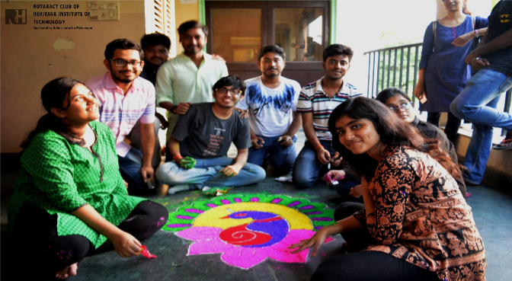


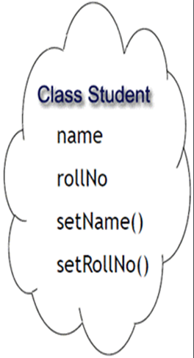
What comes first? Object or class ?
Nilina Bera

Slide 4
OOA is an iterative stage of analysis, which takes place during the software development life cycle, that aims to model the functional requirements of the software while remaining completely independent of any potential implementation requirements.
To accomplish this task via OOAD practices, an object-oriented analysis will focus everything through the lens of objects. This forces OOA to combine all behaviors, characteristics, and states together into one analysis process, rather than splitting them up into separate stages, as many other methodologies would do.
To accomplish this goal, a typical OOA phase consists of five stages:
Find and define the objects.
Organize the objects.
Describe how the objects interact with one another.
Define the external behavior of the objects.
Define the internal behavior of the objects.
Nilina Bera

Slide 5
What is Object-Oriented Design?
The process of object-oriented design is really just an extension of the object-oriented analysis process that preceded it, except with a critical caveat: the consideration and implementation of constraints.
For example, with an analyzed object in hand, such as an object model, we must now consider how that object would actually be designed and implemented, which will often require the application of constraints, such as software or hardware platforms, time and budgetary limitations, performance requirements, developer aptitude, and so forth.
Put another way, the OOD process takes the theoretical concepts and ideas planned out during the OOA stage, and tries to find a way to design and tangibly implement them, usually via code using whatever language and platforms the development team has settled upon.
If OOA is the what, then OOD is the how.
Nilina Bera

Slide 6
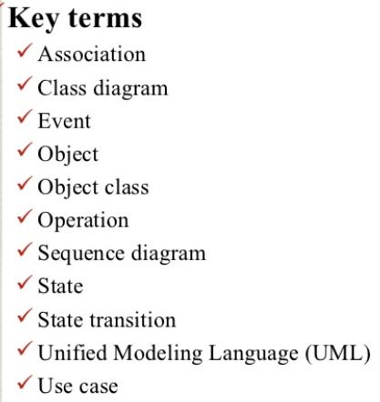
What we are going to learn in OOAD?
Nilina Bera

Slide 7
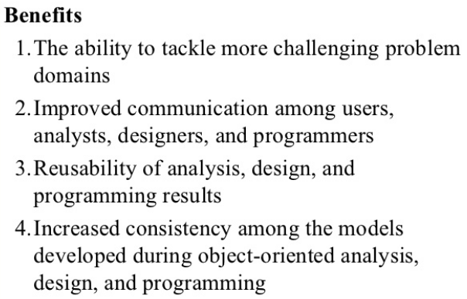
Nilina Bera

Slide 8
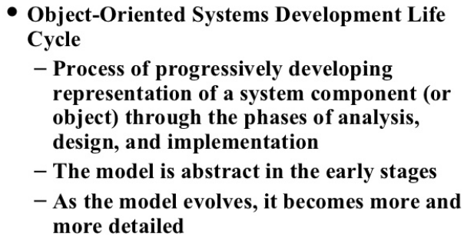
Nilina Bera

Slide 9
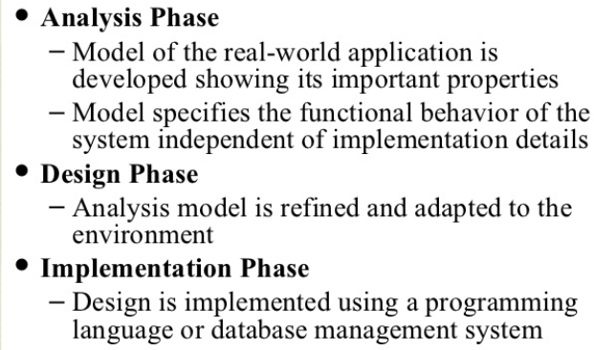
The Object Oriented Systems Development Life Cycle
Nilina Bera

Slide 10
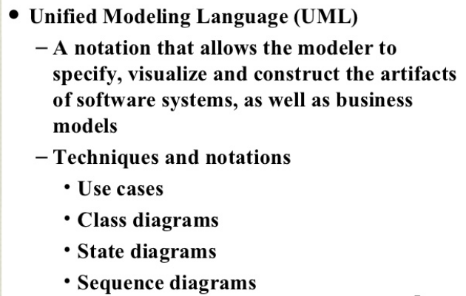
The Object Oriented Systems Development Life Cycle
Nilina Bera

Slide 11

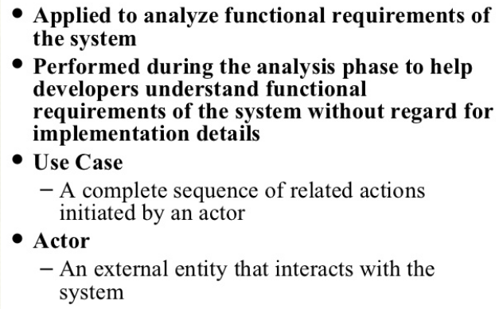
Nilina Bera

Slide 12
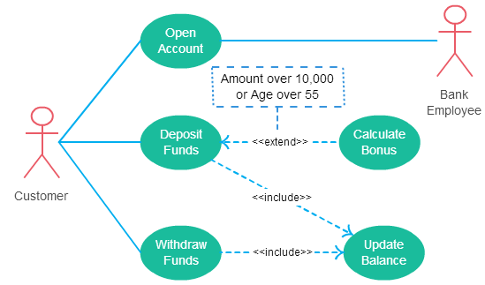
Use Case example:
Nilina Bera

Slide 13
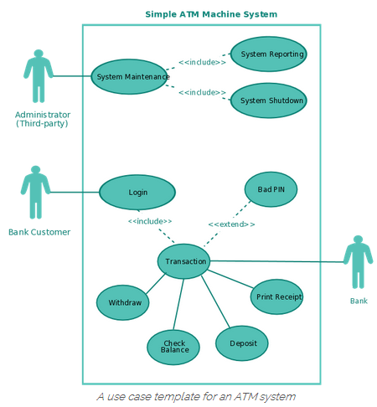
Use Case example:
Nilina Bera

Slide 14
What we are going to learn ?
• Explain the features represented by a class diagram.
• Explain the relationships among different types of classes by means of association.
• Explain the relationships among different types of classes by means of aggregation.
• Explain the relationships among different types of classes by means of composition.
• Draw interaction diagrams for any given problem.
• Explain the tradeoff between inheritance and aggregation/ composition
• Bring out a comparison of the three relationships: association, aggregation and composition
Nilina Bera

Slide 15
Class diagrams
A class diagram describes the static structure of a system. It shows how a system is structured rather than how it behaves. The static structure of a system comprises of a number of class diagrams and their dependencies.
The main constituents of a class diagram are classes and their relationships: generalization, aggregation, association, and various kinds of dependencies.
Nilina Bera

Slide 16
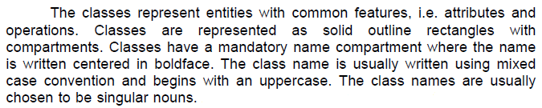
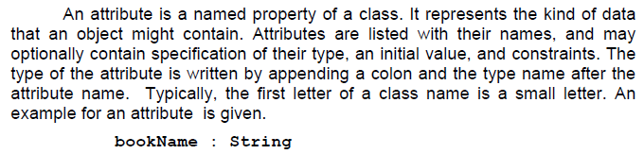
Classes :
Attributes :
Nilina Bera

Slide 17
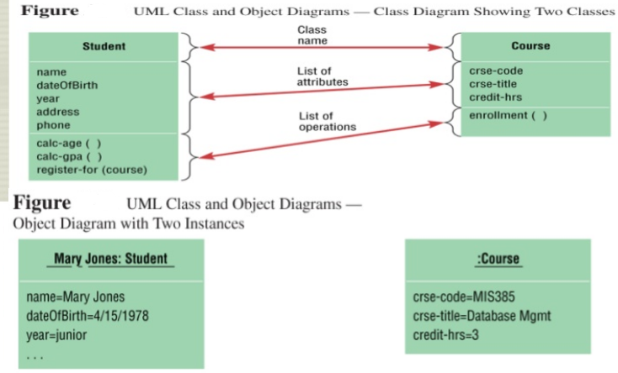
Nilina Bera

Slide 18
Operation
Operation is the implementation of a service that can be requested from any object of the class to affect behavior. An object’s data or state can be changed by invoking an operation of the object. A class may have any number of operations or no operation at all. Typically, the first letter of an operation name is a small letter.
Abstract operations are written in italics. The parameters of an operation (if any), may have a kind specified, which may be ‘in’, ‘out’ or ‘inout’. An operation may have a return type consisting of a single return type expression.
An example for an operation is given.
issueBook(in bookName):Boolean
Nilina Bera

Slide 19
Association
Associations are needed to enable objects to communicate with each other.
An association describes a connection between classes.
The association relation between two objects is called object connection or link.
Links are instances of associations.
A link is a physical or conceptual connection between object instances.
For example, suppose Amit has borrowed the book Graph Theory. Here, borrowed is the connection between the objects Amit and Graph Theory book.
Mathematically, a link can be considered to be a tuple, i.e. an ordered list of object instances.
An association describes a group of links with a common structure and common semantics.
For example, consider the statement that Library Member borrows Books.
Here, borrows is the association between the class LibraryMember and the class Book.
Nilina Bera

Slide 20

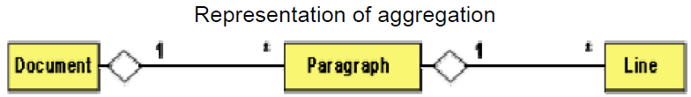
“Many books may be borrowed by a Library Member”
Aggregation
Aggregation is a special type of association where the involved classes represent a whole-part relationship.
The aggregate takes the responsibility of forwarding messages to the appropriate parts. Thus, the aggregate takes the responsibility of delegation and leadership.
When an instance of one object contains instances of some other objects, then aggregation (or composition) relationship exists between the composite object and the component object.
Aggregation is represented by the diamond symbol at the composite end of a relationship.
Nilina Bera

Slide 21
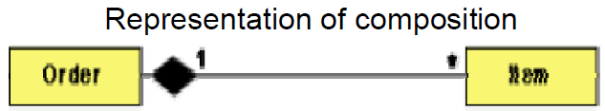
Composition
Composition is a stricter form of aggregation, in which the parts are existence-dependent on the whole.
This means that the life of the parts closely ties to the life of the whole.
When the whole is created, the parts are created and when the whole is destroyed, the parts are destroyed.
A typical example of composition is an invoice object with invoice items. As soon as the invoice object is created, all the invoice items in it are created and as soon as the invoice object is destroyed, all invoice items in it are also destroyed.
The composition relationship is represented as a filled diamond drawn at the composite-end.
Nilina Bera

Slide 22
Inheritance vs. Aggregation/Composition
• Inheritance describes ‘is a’ / ‘is a kind of’ relationship between classes (base class - derived class) whereas aggregation describes ‘has a’ relationship between classes.
Inheritance means that the object of the derived class inherits the properties of the base class;
Aggregation means that the object of the whole has objects of the part.
For example, the relation “cash payment is a kind of payment” is modeled using inheritance;
“purchase order has a few items” is modeled using aggregation.
Inheritance is used to model a “generic-specific” relationship between classes whereas aggregation/composition is used to model a “whole-part” relationship between classes.
Nilina Bera

Slide 23
Inheritance vs. Aggregation/Composition
Example: A BusinessPartner might be a Customer or a Supplier or both.
Check Fig (a). During the lifetime of Customer→Supplier relationship, a business partner might become a customer as well as a supplier, or it might change from one to the other.
In such cases, we prefer aggregation instead (see Fig (b)).
Here, a business partner is a Customer if it has an aggregated Customer object, a Supplier if it has an aggregated Supplier object and a "Customer_Supplier" if it has both. Here, we have only two types.
Hence, we are able to model it as inheritance.
Nilina Bera

Slide 24
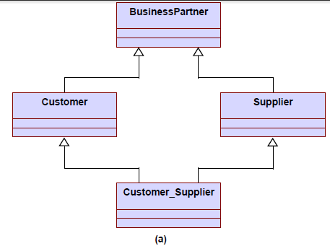
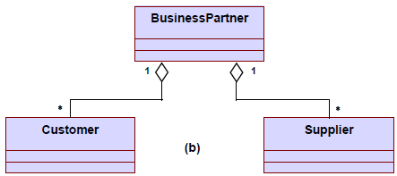
Nilina Bera

Slide 25
Interaction Diagrams
Interaction diagrams are models that describe how group of objects collaborate to realize some behavior. Typically, each interaction diagram realizes the behavior of a single use case. An interaction diagram shows a number of example objects and the messages that are passed between the objects within the use case.
Sequence Diagram
A sequence diagram shows interaction among objects as a two dimensional chart. The chart is read from top to bottom. The objects participating in the interaction are shown at the top of the chart as boxes attached to a vertical dashed line. Inside the box the name of the object is written with a colon separating it from the name of the class and both the name of the object and the class are underlined. The objects appearing at the top signify that the object already existed when the use case execution was initiated. However, if some object is created during the execution of the use case and participates in the interaction (e.g. a method call), then the object should be shown at the appropriate place on the diagram where it is created.
Nilina Bera

Slide 26
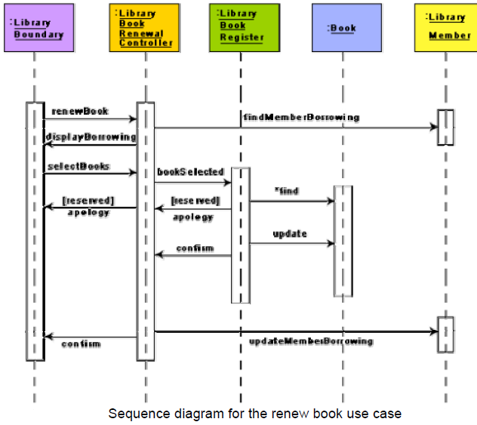
Nilina Bera

Slide 27
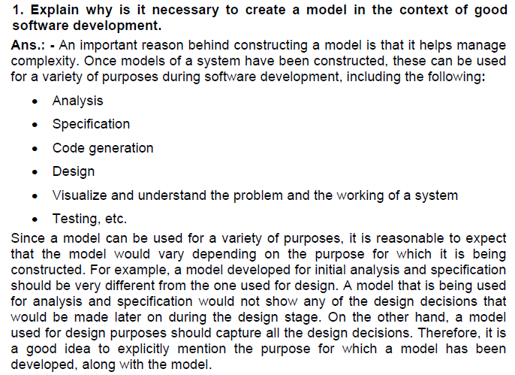
Question – n- Answer session……
Nilina Bera

Slide 28
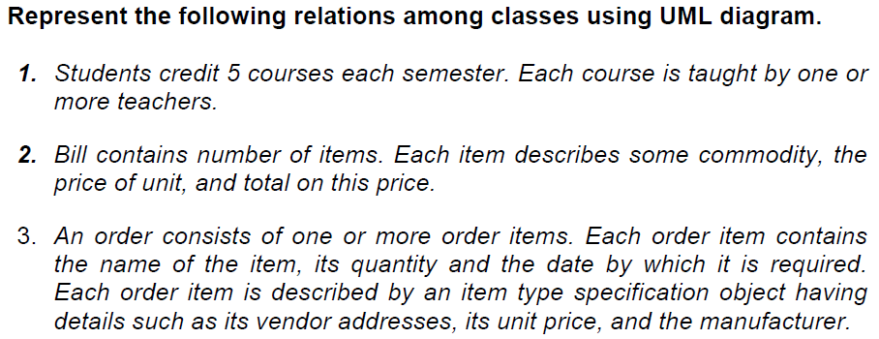
Question – n- Answer session……
Nilina Bera

Slide 29
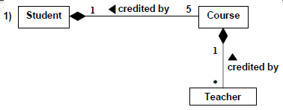
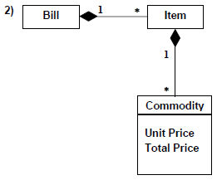
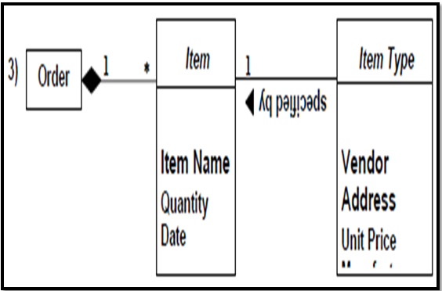
Nilina Bera

Slide 30
Question – n- Answer session……
What is the necessity for developing use case diagram?
Ans.: - From use case diagram, it is obvious that the utility of the use cases are represented by ellipses. They along with the accompanying text description serve as a type of requirements specification of the system and form the core model to which all other models must conform. But, what about the actors (stick person icons)? One possible use of identifying the different types of users (actors) is in identifying and implementing a security mechanism through a login system, so that each actor can involve only those functionalities to which he is entitled to. Another possible use is in preparing the documentation (e.g. users’ manual) targeted at each category of user. Further, actors help in identifying the use cases and understanding the exact functioning of the system.
Nilina Bera

Slide 31
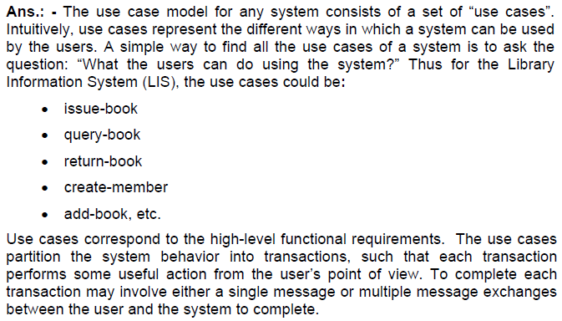
How to identify use cases of a system?
Nilina Bera

Slide 32

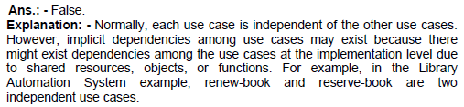
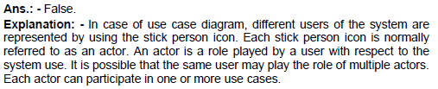
Mark the following as either True or False……
Nilina Bera

Slide 33

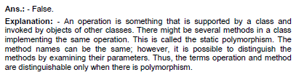

Mark the following as either True or False……
Nilina Bera

Slide 34


Mark the following as either True or False……
Nilina Bera

Slide 35

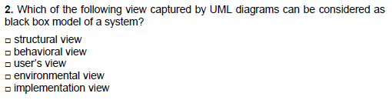

Multiple Choice Questions ……
Nilina Bera

